Slide 1
03 | Create and Manage Virtual Machines

Slide 2
Module Overview
Workloads
Networking
Configuration Management
Disk Management

Slide 3
Workloads

Slide 4

















Azure Marketplace
Service Templates and VM Images for Workloads
Windows Server 2012 R2
Ubuntu Server 14.04 LTS
CentOS 6.5
SUSE Linux
Enterprise Server
openSUSE 13.1
Oracle Linux 6.4.0.0.0
SQL Server 2014 Standard
Oracle Database 11g R2
SharePoint Server Farm
Microsoft Dynamics
GP 2013
Zulu 8
BizTalk Server 2013
SAP HANA
Developer Edition
Puppet Enterprise 3.2.3
Barracuda Web Application
Oracle WebLogic
Server 12.1.2
Visual Studio Ultimate 2013
Windows 8.1 Enterprise

Slide 5
VM Depot
http://vmdepot.msopentech.com
The VM Depot is a community-driven collection of templates for Virtual Machines running in Azure.
Virtual Machines can be created automatically or using the Management Portal from the VM Depot images
You can contribute new images to the VM Depot

Slide 6
Create an Azure Virtual Machine using Provided Images

Slide 7
Configuration Management

Slide 8
Capturing a VM Image
Existing Virtual Machines can have an “image” captured to use as a template for other Virtual Machines
Steps
Use Remote Desktop to connect to running VM
Open an elevated command prompt
Run the System Preparation Tool (sysprep)
Use the “Capture” button in the Management Portal

Slide 9
VM Agent
VM Agent is a very lightweight background process that provides an entry point for Microsoft and partners to configure and manage Virtual Machines
Installed on a Virtual Machine by default (can be disabled)
Allows VM Extensions to be installed on an Azure Virtual Machine
VM Extensions are software components that can extend an existing Virtual Machine
Multiple VM Extensions can be installed on the same VM
The BGInfo desktop tool is a VM Extension
Notes:
20532
3: Managing Infrastructure in Azure™

Slide 10

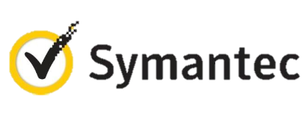


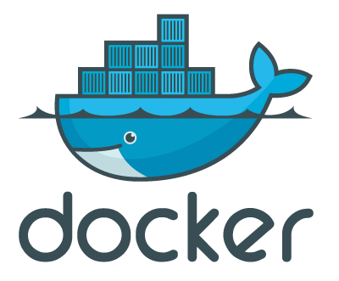

VM Extensions
Installable components to customize VM instances
Enable various DevOps scenarios
Can be added, updated, disabled or removed at any time
Managed via portal, PowerShell and Management APIs
Microsoft Azure

Slide 11
PowerShell Desired State Configuration
Desired State Configuration (DSC)
Is an extension of PowerShell
New language features
New cmdLets
Extra resources
Focuses on the configuration of software environments
Can be used to maintain existing configurations or manage new configurations
Notes:
20532
3: Managing Infrastructure in Azure™

Slide 12
Networking

Slide 13
Endpoints
Enable connectivity to your Virtual Machines
Route requests from Cloud Service to Virtual Machine using an public port and a private port
Can be added to a Load-Balanced Set
Can create a list of allowed/denied IP Address Ranges using Access Control List (ACL)
ACL set to Allow * (all) by default

Slide 14
Endpoints
Direct Endpoints
Load Balanced Endpoints
Public and Private Ports may vary
Other Options
Reserved Static IP for VM Instance
Reserved IP for Cloud Service
SQL
Port 1433
SQL Client: Port 1455
SQL Client: Port 1433
Web Browser: Port 80
IIS
cloud service
IIS

Slide 15
Endpoints
Custom Application Workload on Azure VMs
Port 80
Web Application
IIS
IIS
Internal Load Balancer SQL Server Always On
SQL
SQL
SQL
Database
Notes:
20532
2: Establishing a Development Environment using Azure Virtual Machines

Slide 16
Virtual Networks
Extend your trust boundary
Site-to-Site
ExpressRoute
Point-to-Site

Slide 17
Virtual Networks Key Concepts
Network Security Groups
Subnets
Gateway (Service)
IP Address Ranges

Slide 18
Customizing Virtual Network Configuration using XML
The Management Portal provides a convenient wizard for creating your Virtual Network and configuring the VNET.
A network configuration file (netcfg) can alternatively be used to define your virtual network’s settings.
Network configuration files can be edited for an existing VNET.
The netcfg schema is available on MSDN for reference
Notes:
20532
3: Managing Infrastructure in Azure™

Slide 19
Creating a Virtual Network

Slide 20
Virtual Machine Availability Sets
Update Domains are honored by host OS updates
Fault Domain
Fault Domain
Rack
Rack
Availability Set
Virtual Machine
Virtual Machine
IIS1
IIS2
UD #1
UD #2
Availability Set
Virtual Machine
Virtual Machine
SQL1
SQL2
UD #1
UD #2

Slide 21
Scaling Virtual Machines
Virtual Machines can be generally scaled in two directions
Horizontal
Duplicate Virtual Machine instances are added
Vertical
Virtual Machine tiers can be changed for a current instance.
Virtual Machines in an Availability Set can be auto-scaled horizontally
Scaling rules are assigned to a schedule

Slide 22
Auto-Scaling Virtual Machines
Minimum: 2, Maximum: 5
VMs are Shut Down to save costs
Later on, VMs may again be underutilized
Virtual Machines Started
Usage Increases
Light Usage
Virtual Machines (Availability Set)

Slide 23
Auto-Scaling Virtual Machines
Virtual Machines can automatically scale horizontally by monitoring specific metrics:
Target CPU
When the average utilization of the CPU is above a certain threshold, new instances are created. When it is below the floor, instances are removed.
Queue
You can establish a target amount of queue messages per instance. New instances will be created to handle additional messages.

Slide 24
Disk Management
Bret Stateham | Senior Technical Evangelist
Sidney Andrews | Cloud Applications Consultant

Slide 25
Disks and Images
OS Images
Microsoft
Partner
User
Base OS image for new Virtual Machines
Sys-Prepped/Generalized/Read Only
Created by uploading or by capture
Disks
OS Disks
Data Disks
Writable Disks for Virtual Machines
Created during VM creation or during upload of existing VHDs.

